Slide 1




Revitalizing Stock Predictions with Machine Learning Algorithms – An Empirical Study
IEEE India Council International Conference 2020
Track Number: 7 (WIE)
Presented By :
Shubham Sood
Vaibhav Gaur
Lisha Uppal
Manpreet Kaur

Slide 2
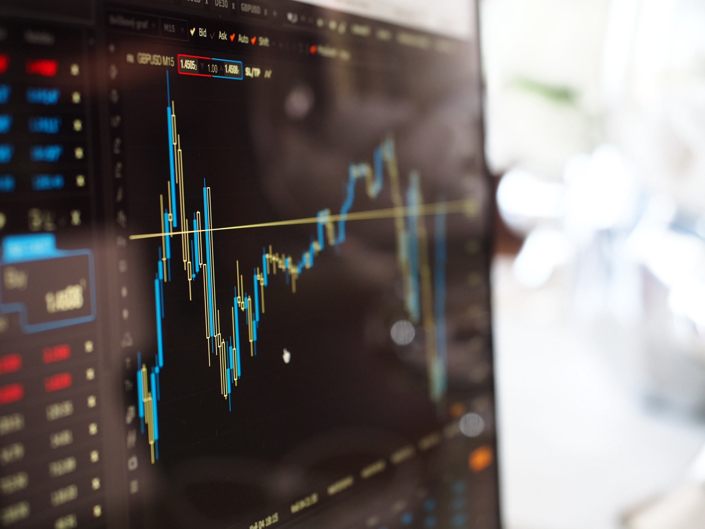
Introduction
In recent years Machine Learning has transformed the world in many ways from its applications in computer vision medical science as well as many other domains. Humans have become dependent on data and information in society and due to this, the technology is evolving. We could not help but wonder, can the same technique be used to predict something non-linear and non-stationary like the Stock Market?
The stock market is one of the many exciting topics to be researched by students and scholars alike. Stock market prediction is a vast topic with a lot of dependencies like the company's recent product releases and its history etc. This all goes into the study of stock prices at the time of investment. We have used the different Supervised Learning Algorithms and LSTM Architecture and tried to evaluate them to check which one of them best suits to predict the stock prices.

Slide 3
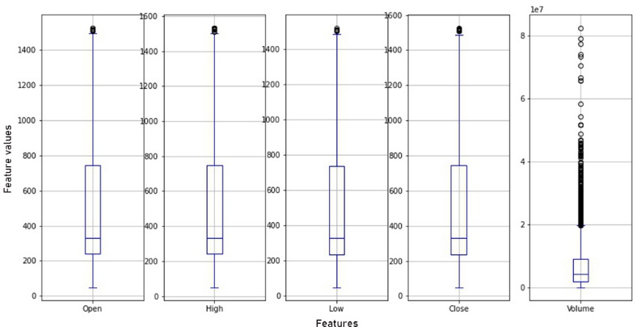
DATASET AND PRE-PROCESSING
In this proposed model, we have used primary data consisting of stock prices for the well-known company Google from Yahoo! Finance from the year 2004 to May 2020. The dataset includes several attributes details of which are given below.
Various features of the gathered dataset which is used for Stock Price Prediction are as follows–
Date- This gives the date corresponding to which the stock prices are stored.
Open- The open is the opening price at which the market opens.
High- It represents the highest price at which the stock has reached on the given day.
Low- It represents the most economical value at which the stock has concluded on the given day.
Close- The Close is the closing price, and it is the most crucial price as it is the closing price for the given period.
Volume- It refers to the number of shares that are being sold or traded on a presented day.
We distribute the dataset in the training phase and in the testing phase, where 80% of the data goes to the training phase and 20% of the data goes to the testing phase.

Slide 4
RELATED WORK
Stock Market Prediction Using Machine Learning Algorithms
K. Hiba Sadia et al. in [1] proposed a prediction system based on Machine Learning algorithm Support Vector Machine (SVM) and Random Forest Classifier. We observed from this paper that the dataset they used was downloaded from Kaggle, which is more kind of raw and has to be pre-processed before making any prediction.
A new approach of stock price prediction based on logistic regression model
A Logistic Regression based model using feature index values and significant time-effectiveness has been proposed by J. Gong et al. in [2]. They have mentioned that their method of daily trading prediction is better in complexity and accuracy than any other models like the RBF-ANN model for prediction.
Predicting Trend in Stock Market Exchange using Machine Learning Classifiers
A prediction model where they measure the best algorithm before and after applying the Principal Component Analysis (PCA) has been presented by W. Khan et al. in [3]. They have concluded that the KNN algorithm gives better performance for stock prediction than SVM and Naive Bayes in terms of both accuracy and MAE (Mean Absolute Error).

Slide 5
MACHINE LEARNING ALGORITHMS
Linear Regression - For optimizing the Linear Regression model, we have used the Learning Rate or abbreviated as α (‘alpha’). Learning Rate for a linear regression can be defined as the constant where the regression intercept line meets the y-axis.
Decision Tree - In Decision Tree, the parameter that we optimized is max_depth. It is the parameter that determines the depth of the tree and how deep the decision node will go. When there is many features in the model, then there will be more splitting in the decision tree and the tree will become complicated, which can lead to overfitting.
K-NN - For the K-NN algorithm, we optimized the parameter K itself. K in K-NN regressor means the predicted output data-point will be the average value of the K nearest neighbours. Keeping a higher value for K helps us to avoid the overfitting of the model.

Slide 6
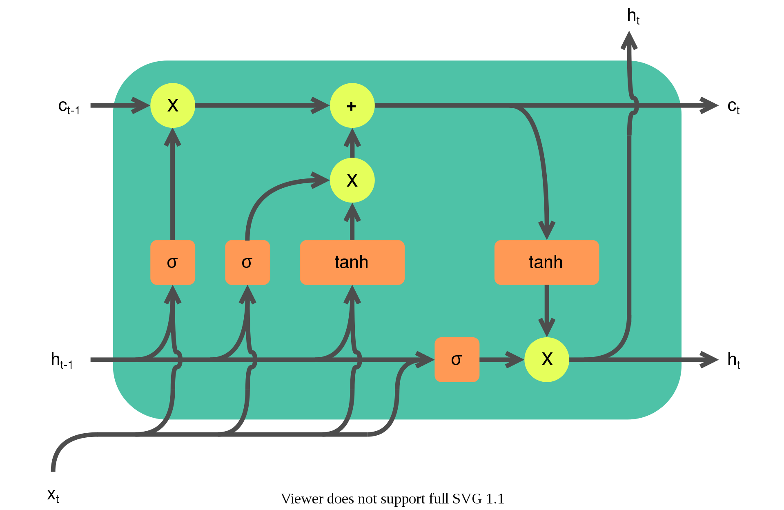
LSTm Model
A model based on LSTM, CNN and RNN have been proposed by Selvin et al. in [6]. They evaluate the model performance based on percentage error. They train their model on stock prices of Infosys and can predict the stock prices of TCS and Cipla.
It is proposed by [13] to overcome the vanishing gradient problem that the Recurrent Neural Network (RNN) faced when implemented on the extended data sequence. In LSTM, the hidden layers which generally all neural network uses are replaced with memory cells, which are a series of gates. These gates decide whether to pass the particular information to the next cell or to ignore it. There are three gates in LSTM:-
Input Gate
Forget Gate
Output Gate

Slide 7
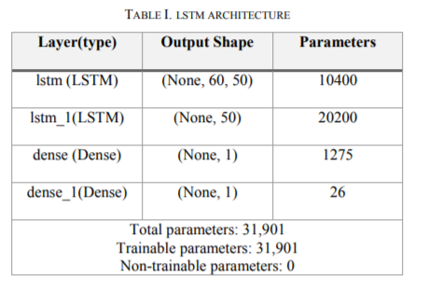
LSTM Architecture
We have employed Keras library to implement the LSTM model, which works sequentially, which means layers are sequentially added one after the other. Consequently, we have used four layers of the LSTM model in which the first two-layers take the input of 50 neurons. The third layer, usually known as the "Dense" layer, serves the connection between the second layer and the next Dense layer, which is the output layer. Ultimately, for compiling the model, we consider the two parameters – Adam optimizer and loss function as mean square error.

Slide 8
RESULT
After performing a series of experiments, we arrived at the following results.
The RMSE values of the proposed algorithms with the best-chosen hyperparameters are computed and are shown in Table II. We have observed that LSTM is giving the least RMSE as compared to other Supervised learning algorithms.
After performing the series of observations, we have concluded that the LSTM model has been able to predict prices with the lowest RMSE of 21.83 at 200 epochs (iterations) compared to different variations of epochs as shown in Table III.
Algorithm | Parameters | RMSE
LSTM | Optimizer = Adam, Loss Function = Mean Squared Error | 21.83
Linear Regression | α = 0.1 | 54
Decision Tree | Max Depth = 5 | 59
KNN | K=13 | 149
No. of Epochs | RMSE
50 | 26.94
100 | 23.86
200 | 21.83
300 | 31.37
400 | 49.21
500 | 25.21
Table II. Comparative RMSE value of different algorithms
Table III. lstm model’s rmse value with a different variation of epochs

Slide 9
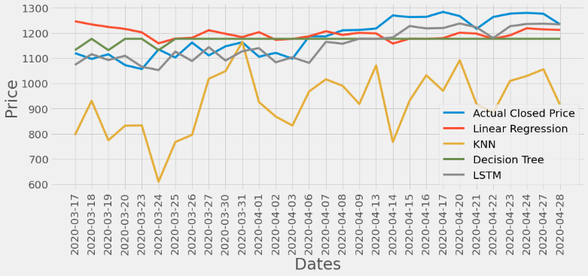
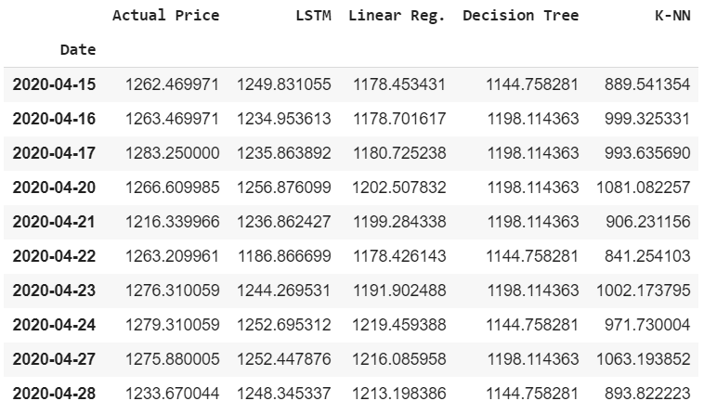
RESULT
The LSTM model is the best-proposed model as it is depicting the near representation of predicted values from the actual stock price value and has the least RMSE value. Thus, for all intent and purposes, we can rely on the prices that LSTM has predicted. Whereas Linear Regression, Decision Tree and KNN are not able to predict the prices as accurately as LSTM. [fig 1]
The LSTM model that we worked on can thus have predicted the stock prices most accurately. A detailed comparison between the price predicted by all the models with the actual price can be seen in [fig 2].
Fig 1
Fig 2

Slide 10
CONCLUSION AND FUTURE WORK
In our research work, we have implemented several algorithms just to test their accuracy over the stock prices dataset. That leads us to the conclusion that it's possible to identify the various patterns in the stock market, just like the trader does in real life.
For the future work, we propose to develop an API to check the Nifty50 P: E ratio, which can help us in knowing whether it's the time to buy or to sell the shares.
We also propose to experiment with it further using the forex market as well. Still, since the market is very unpredictable and a slight change in a country can make a significant change in its currency, that's why a better-trained model would be required for it to predict forex prices and to help intraday traders.

Slide 11
References
[1] Sadia, K. Hiba, Aditya Sharma, Adarrsh Paul, Sarmistha Padhi, and Saurav Sanyal. "Stock Market Prediction Using Machine Learning Algorithms." IJEAT (2019).
[2] Gong, Jibing, and Shengtao Sun. "A new approach of stock price prediction based on logistic regression model." 2009 International Conference on New Trends in Information and Service Science. IEEE, 2009.
[3] Khan, W., M. A. Ghazanfar, M. Asam, A. Iqbal, S. Ahmad, and Javed Ali Khan. "PREDICTING TREND IN STOCK MARKET EXCHANGE USING MACHINE LEARNING
[6] Selvin, Sreelekshmy, R. Vinayakumar, E. A. Gopalakrishnan, Vijay Krishna Menon, and K. P. Soman. "Stock price prediction using LSTM, RNN and CNN-sliding window model." In 2017 international conference on advances in computing, communications and informatics (icacci), pp. 1643-1647. IEEE, 2017.
[13] Hochreiter, Sepp, and Jürgen Schmidhuber. "Long short-term memory." Neural computation 9.8 (1997): 1735-1780.

